Slide 1
REPS Ratio
June 2014

Slide 2
Ratio Summary

Slide 3
Overall Ratio
History
Systems and Motor engineering desired the highest possible ratios
Had jump-over internal ball return
Didn’t have toothed belts
Historic Constraints
Packaging wasn’t a huge constraint
R&P grease didn’t perform well in cold in ballnut/ballscrew
Ballscrew development is difficult. Not just a question of scaling.
Inertia
Motor speed

Slide 4
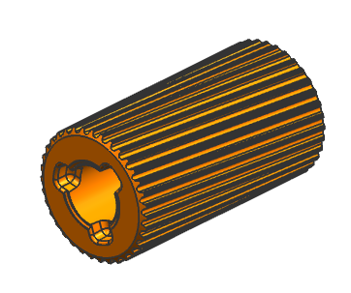
Drive Pulley
History
Original design dictated by overall ratio optimization
Constraints
30 tooth is smallest we want for
Belt radius bending/fatigue concerns
PM pulley wall thickness over a 10 mm motor shaft (12 mm requires larger pulley)
35 tooth is smallest before needing a tensioner
Current Design
Tooth design and width dictated by belt design

Slide 5
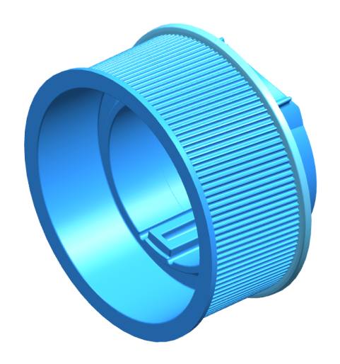
Driven Pulley
History
Steel
Original design dictated by package within bearing bore with bearings that could react the loading
Constraints
Package
Large constrained by size in bore
Small constrained by ballnut plus return guide OD
Current Design
Plastic
124 teeth / ballnut rev
Tooth design and width dictated by belt design

Slide 6
Rack Ball Screw
History
5 mm and 6 mm leads were tried for more ratio
Very small balls
Noisy, poor durability, poor backdrive, poor cold performance
8 mm lead was originally designed for a 25 mm rack
Kinefac rollers didn’t perform well
Constraints
5 degree lead angle minimum rule of thumb
For backdriveability. Came from someone at Thompson Ball Screw.
Manufacturing wants a common lead for all Rack Diameters
Dies are same for 28 mm and 31 mm (Also will be for 26 mm)
Current Design
8 mm lead
Rolled ball track (Profiroll) is used for better NVH performance
Alternatively, grinding creates white noise, however is better for efficiency due to less lead related errors.

Slide 7
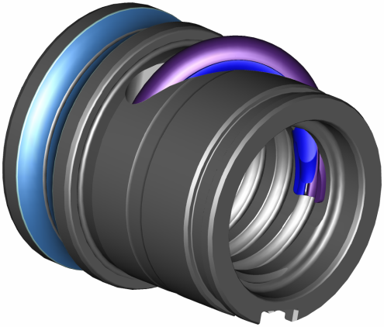
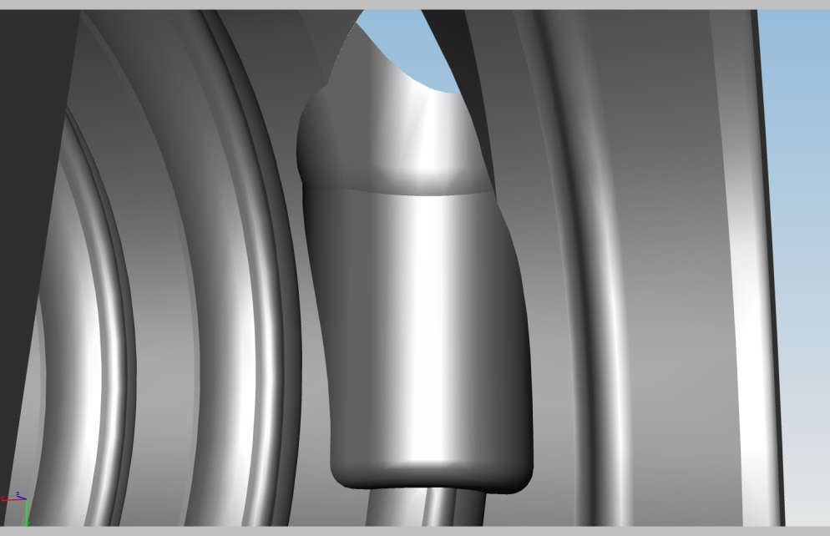
Ball Nut
History
Jump-over internal bank return
Constraints
Minimum lead is constrained by return geometry. Smaller lead would interfere with adjacent track wall thickness at return port.
Lead < 8mm will require a different ball return strategy.
Current Design
External return is very good for NVH and cost
Smaller package return (OD) under development to mitigate pulley roundness issues but could help driven pulley min size constraint if that were ever desired

Slide 8
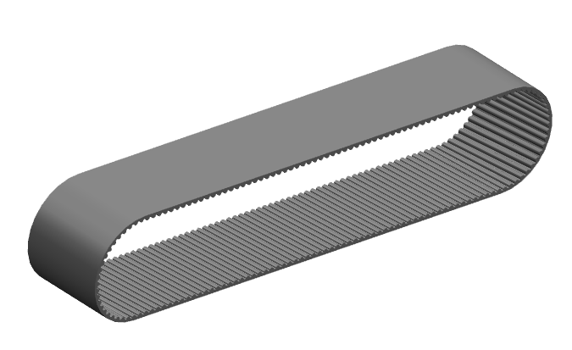
Belt
History
Grooved Poly V-belt
Gates 2 mm pitch, 5 degree helix
Optimal for durability (force into flange) and NVH
Constraints
Durability / bending. Minimum of 30 tooth drive.
Consistent angle for tensioning.
Minimum width (UP375 = 25 mm wide)
Current Design
Gates Standard Tooth
Gates Deep Tooth
2 mm pitch, 5 degree helix, ~.130 mm deeper tooth
Dayco Standard Tooth
2 mm pitch, 6 degree helix, ~.165 mm deeper tooth

Slide 9
Summary
Mechanical Trade-offs for a smaller motor
Larger Package
Tensioner
Higher:
Motor Speed
Inertia
Numerically Higher
Assist Ratio
Belt Ratio
Increased Backdrive
New ball return design
Proliferate BS Manufacturing
1 / Lead
.125

Slide 10
Reference
Nexteer Ball Circuit Designs

